Slide 1

Campus Course Assistant Project
Innovative Campus Assistant Using AWS Services
Group C: Li Hao 25401580 / Xie Juyun 25438131
April 2026

Slide 2
目录
Part 01.
Introduction
Part 02.
Cost Management
Part 03.
Technical Fulfillment
4

Slide 3
Introduction
Overview of the project and its significance
3

Slide 4
Project Objective
What the project aims to achieve
Provide a Telegram chatbot
Offer a functional Telegram chatbot for user interaction.
1
Support multiple commands
Enable commands like /start, /course, /interest for user queries.
2
Facilitate natural conversations
Allow the bot to engage in natural and helpful conversations.
3
4

Slide 5
Cost Management
Strategies and tools for cost efficiency
3

Slide 6
Cost Management Measures
Methods to keep costs under control
1
2
3
4
Use free-trial eligible instance types
Configure scheduled auto-stop
Remove unused resources
Set CloudWatch billing alerts
Strictly utilize instance types that qualify for free trials to minimize expenses.
Set up automated stopping of instances during non-operational hours to save costs.
Regularly delete unused snapshots, Elastic IPs, and temporary resources to avoid charges.
Implement CloudWatch alerts to receive notifications about potential unexpected costs.
4

Slide 7
Technical Fulfillment
Evidence of meeting technical requirements
3

Slide 8
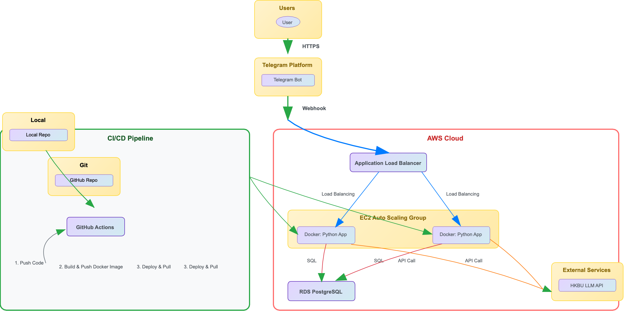
System Architecture Diagram

Slide 9
Must-Have Requirements Compliance
Implementation and proof of essential features
01
02
Telegram Chatbot Functionality
Cloud Database for Data Logging
03
04
Cloud Hosting Application
LLM API Integration
05
06
Git Management
Cloud Monitoring & Cost Control
4

Slide 10

Nice-to-Have Enhancements
Additional features implemented for better performance
1
DevOps Good Practices
Utilize GitHub Actions CI/CD pipeline for automated testing, building, and deploying to the main branch on push, ensuring efficient and reliable software delivery.
2
Load Balancing
Implement AWS Application Load Balancer (ALB) to evenly distribute traffic across multiple EC2 instances, enhancing system scalability and availability.
3
Security Measurements
Enforce security groups to restrict access, apply IAM least privilege, use SSH key login, and ensure no sensitive data is stored in GitHub, maintaining a secure environment.
4

Slide 11
Thank You
Group C: Li Hao 25401580 / Xie Juyun 25438131
April 2026

